Slide 1
Illinois Impact Overview
Capstone 14 Exercise

Slide 2
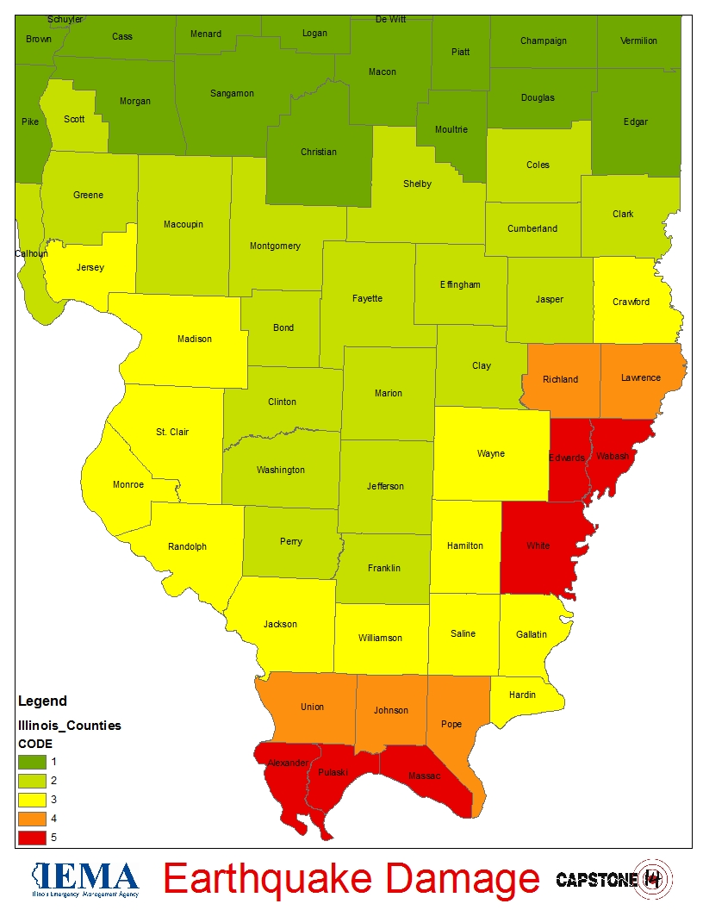
General Impact
Overview
Total Structures Damaged | 18, 347
Total Injured | 12,900
Total Fatalities | 382
Total Seeking Shelter | 125,242
Total Without Power | 1.2 million +
Total Without Water | 900,000 +

Slide 3
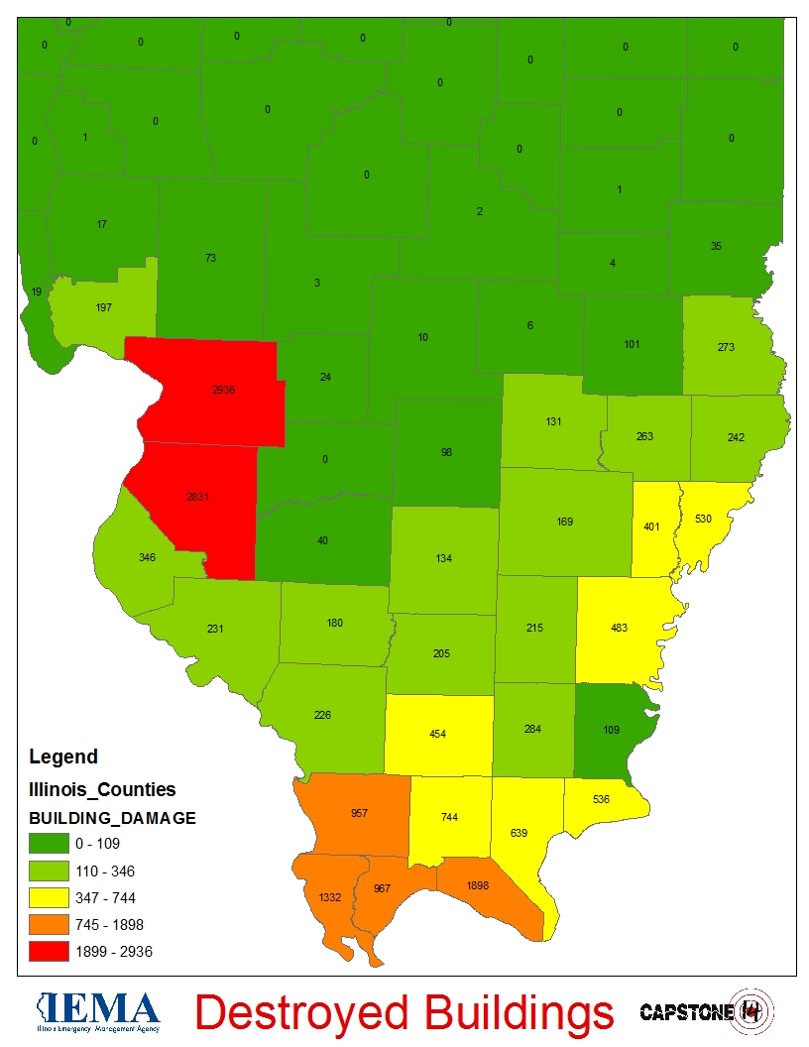
Building Damage
Breakdown of Damage
Residential | 17,430
Commercial, Industrial and Other | 917
Total | 18,347

Slide 4
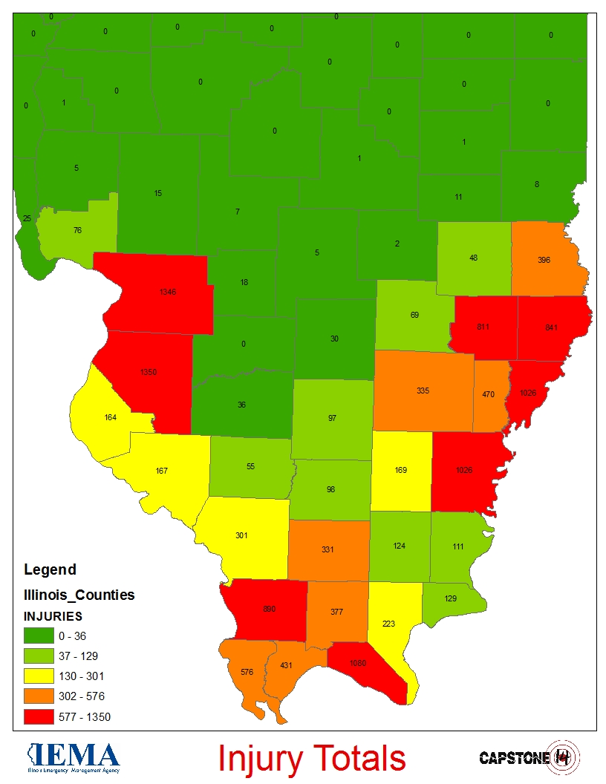
Total Number of Injured
Breakdown of Injuries
Medical Aid Needed | 8,385
Hospital Care Needed | 3,225
Life Threatening | 1,290
Total | 12,900

Slide 5
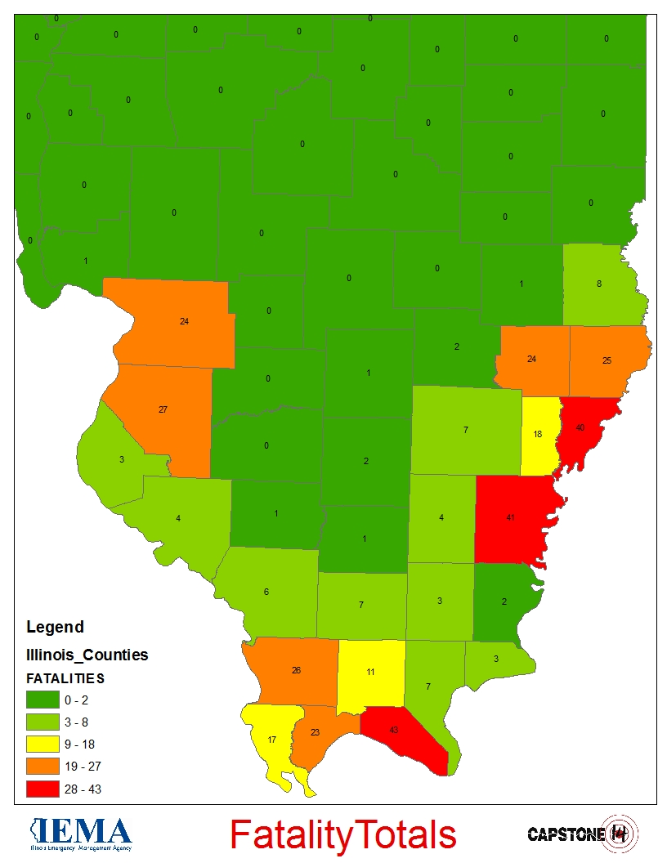
Total Number of Fatalities
Fatalities
Total | 382

Slide 6
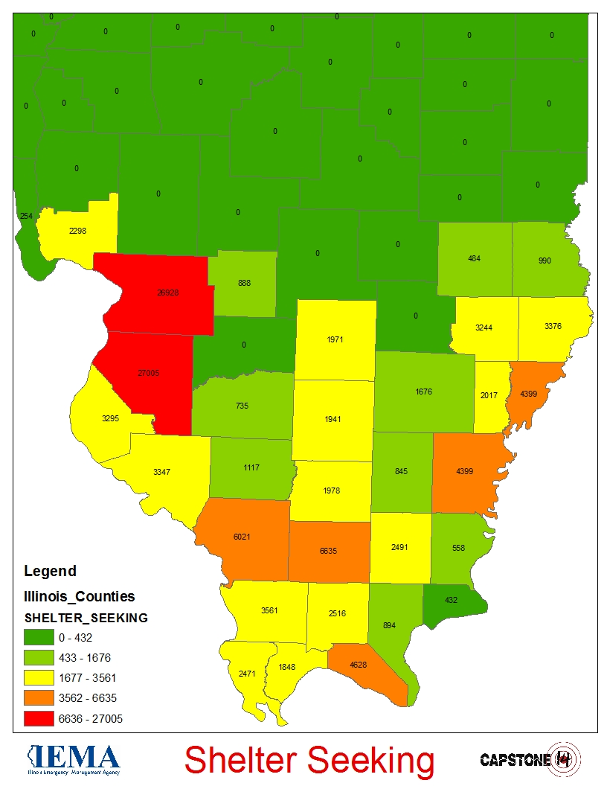
Shelter Seeking Populations
Shelter Seeking
Total | 125,000 +

Slide 7
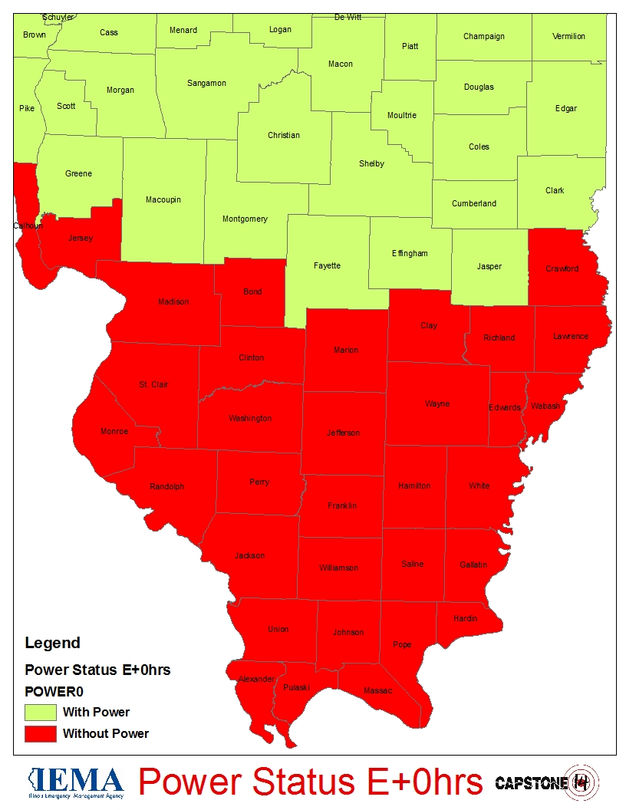
Power Disruptions
Number Affected
Total | 1.2 million +

Slide 8
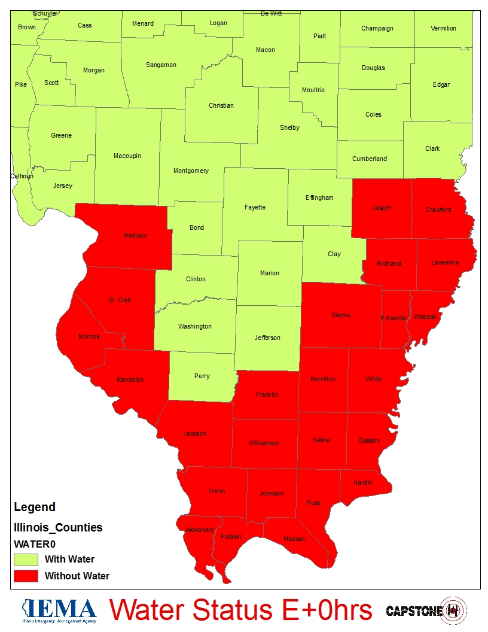
Water System Disruptions
Number Affected
Total | 900,000 +

Slide 9
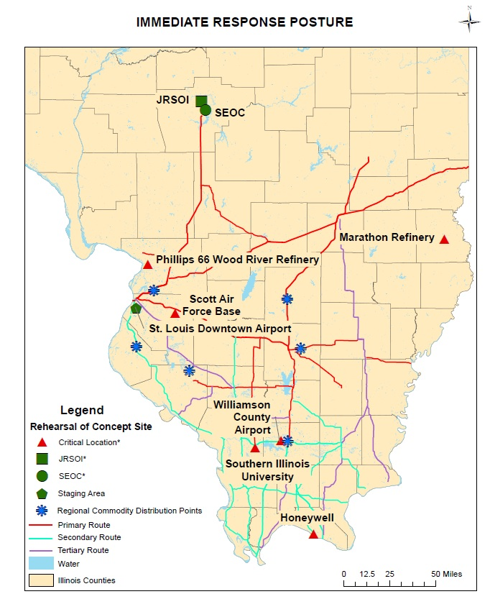
Immediate Priorities (E+72hrs)
Priorities
Major Supply Routes (MSRs)
Joint, Receiving, Staging, On-Ward Movement and Integration (JRSOI)
State Forward Operating Bases (SFOBs)
Regional Commodity Distribution Points (RCDPs)
Critical Locations
Phillips 66 Wood River Refinery
Marathon Robinson Refinery
Scott Air Force Base
Williamson County Airport
Southern Illinois University
Honeywell Uranium Processing Plant

Slide 10
Illinois Resource Assessment

Slide 11
Planning Metrics
USAR – Major metropolitan areas, population of 100,000 or more with multi-story/multi-family structures
TRT – One per County for initial response
SAR – One per County for initial response (Ground & Aerial)
IMT – Per Area Command, State Forward Operating Base, and established JRSOI
EOC Team – Per State EOC
EMAC A-Team – Per State EOC (24/7 shifts)
Bldg/Bridge Inspection – Per County
HAZMAT – Known infrastructure assessment (refineries, chemical plants, etc)
Ambulance Strike Team – Based on population density, casualty estimates, and transport distance (10 ambulance per team)
Med ERT – Per Damage Estimate of Medical Infrastructure (2 per hospital)
Water Rescue – Per major waterway in impacted area
Commo Strike Team – 2 Per Area Command, 1 per State Forward Operating Base, and 1 per established JRSOI
Debris Removal – 1 per county
LE Strike Team – 2 per Area Command. 2 additional for population >100,000
Crowd Control - Major metropolitan areas, population of 100,000 or more

Slide 12
Planning Metrics
QUESTIONS?

