Slide 1
Alabama Impact Overview
Capstone 14 Exercise

Slide 2
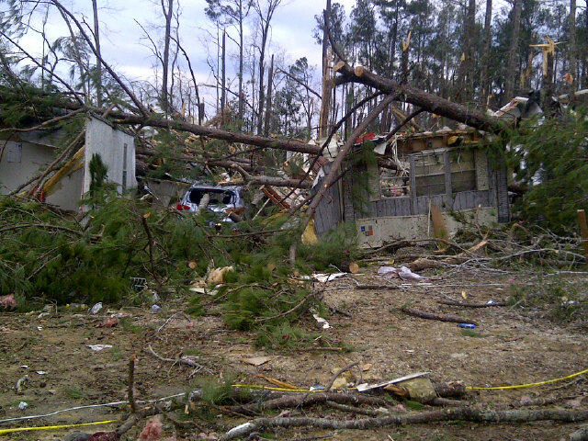
Standing Priorities
Life Saving
Incident Stabilization
Protection of Property
Needs/Damage Assessment

Slide 3
AEMA SEOC Responsibilities
Provide timely and accurate information for senior elected officials and the general public.
Manage the flow of state/federal/private resources, services, and personnel to the incident.
Establish and provide a unity of response, recovery, coordination, and control.

Slide 4
21 Socially Impacted
Autauga
Baldwin
Bibb
Bullock
Choctaw
Clarke
Dallas
Elmore
Escambia
Etowah
Fayette
Geneva
Hale
Lamar
Lowndes
Macon
Marengo
Mobile
Pickens
Russell
Tuscaloosa
Notes:
Based on the Mid-America Earthquake Center data (MAE) center data, no counties in the state meet the requirements which define a county as impacted, such as damage to:
Critical infrastructure
Substantial building damage
Significant structural damage to critical infrastructure
Far lower economic impacts than some counties in Kentucky, Tennessee, and Mississippi

Slide 5
General Impact
Overview
Total Structures Damaged | 19220
Total Injured | 921
Total Fatalities | 28
Total Seeking Shelter | 56,094
Total Without Power | 68,412
Total Without Water | No water outages
Note: temporary housing and shelters are available within the county
Notes:
A large portion of damaged buildings are residential structures. Only 3,000 at least moderately damaged structures are wood construction, while 11,100 are manufactured housing. A large portion of complete damage, however, is attributed to wood structures. Estimates show a large portion of damage occurs in Mobile County is along the Gulf Coast and very far from the fault rupture. This is due to high liquefaction susceptibility. This is the process in which soils lose their ability to carry loads (such as buildings and other infrastructure) b/c the soil suddenly turns from a solid state to a liquid state.

Slide 6
Building Damage
Breakdown of Damage
Residential | 6,200
Other Residential | 12,100
Commercial, Industrial and Other | 920
Total | 19,220

Slide 7
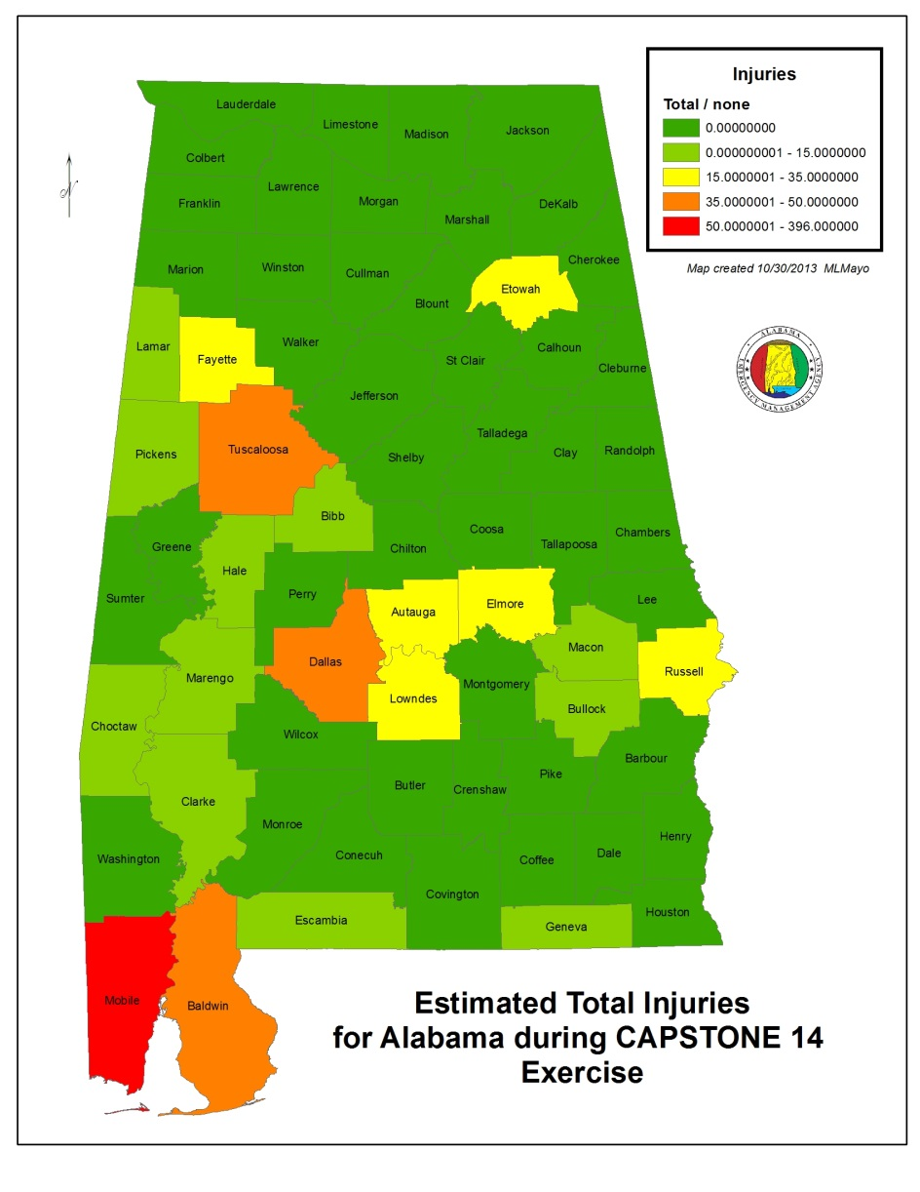
Total Number of Injured
Breakdown of Injuries
Medical Aid Needed | 726
Hospital Care Needed | 179
Life Threatening | 16
Total | 921

Slide 8
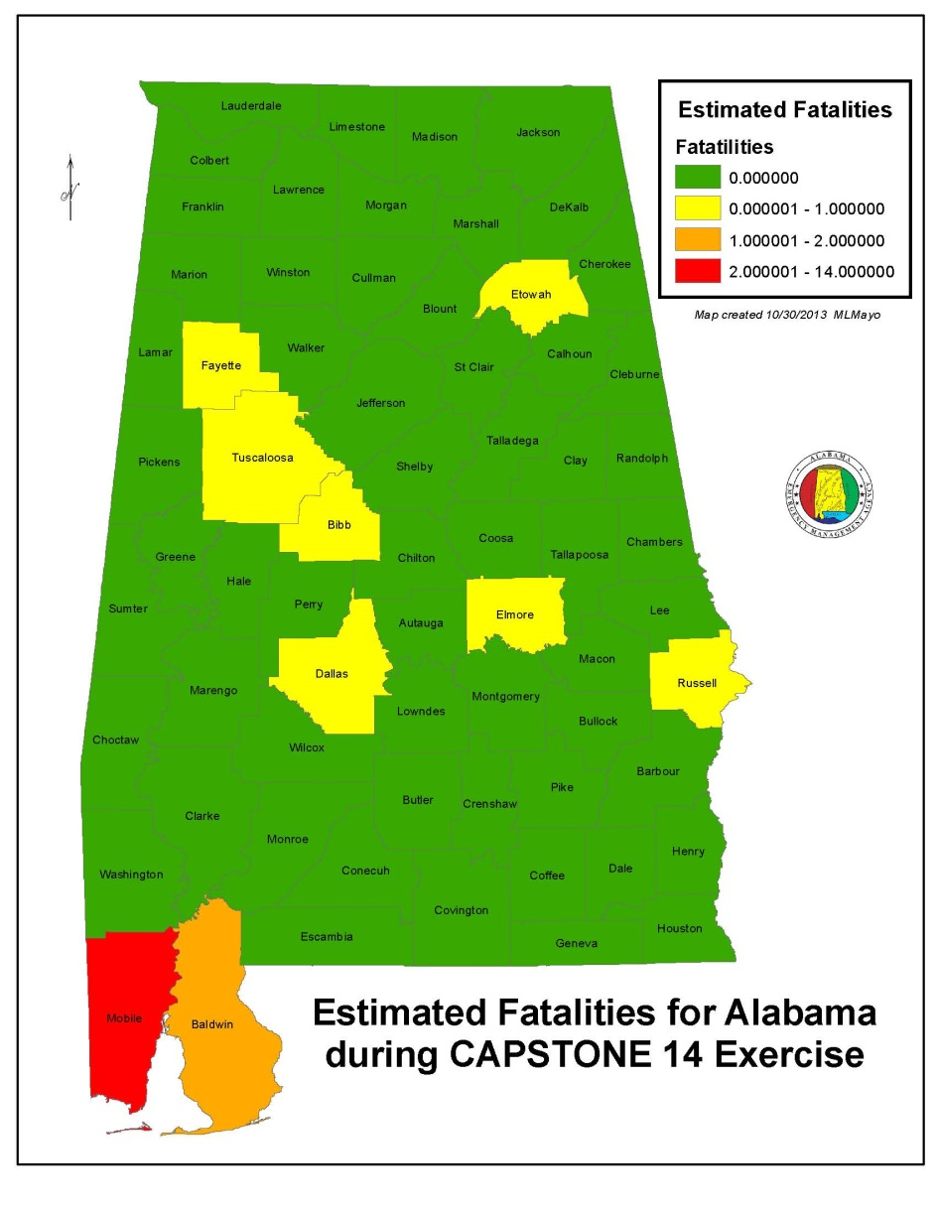
Total Number of Fatalities
Fatalities
Total | 28

Slide 9
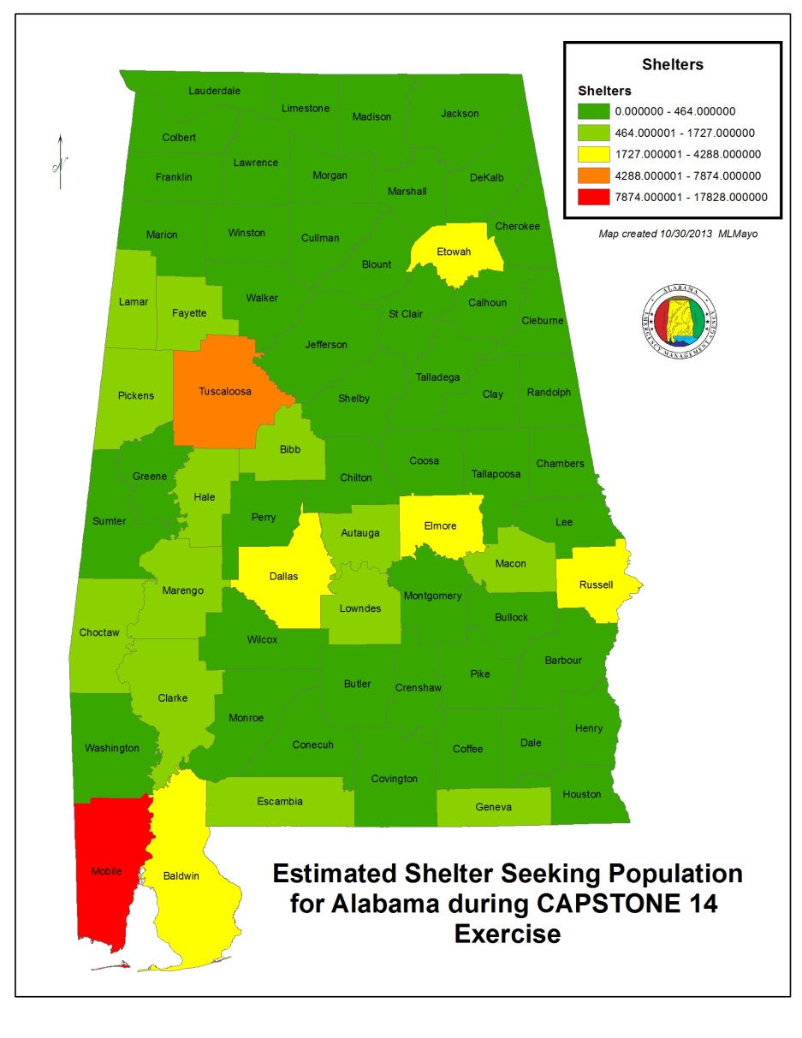
Shelter Seeking Populations
Shelter Seeking
Total | 56,094
Note: temporary housing and shelters are available within the county

Slide 10
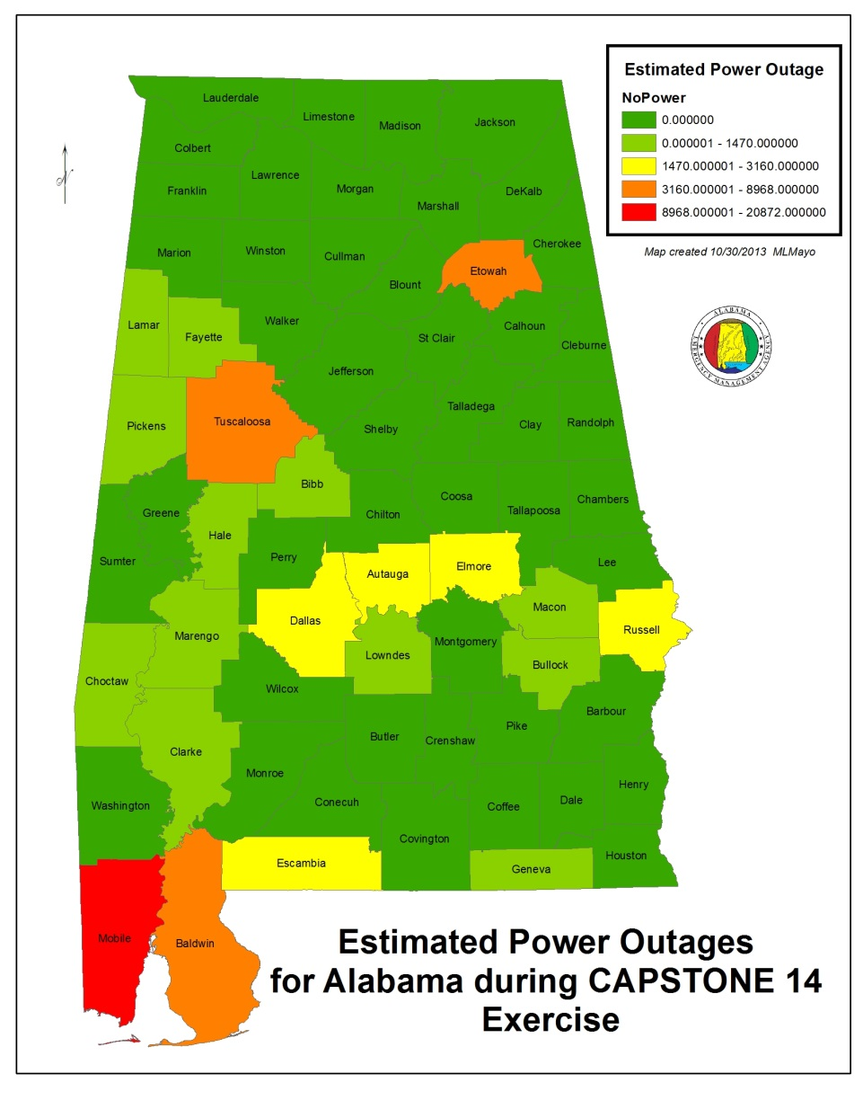
Power Disruptions
Number Affected
Total | 68,412

Slide 11
Water System Disruptions
Number Affected No outages

Slide 12
Immediate Priorities (E+72hrs)
Incident Stabilization
Objectives
Major Transportation Routes
Joint, Receiving, Staging, Onward Movement and Integration (JRSOI)
State Divisions (SAR)
Regional Commodity Distribution Points (RCDPs)

Slide 13
Planning Metrics
1 USAR – Major metropolitan areas, population of 100,000 or more with multi-story/multi-family structures
5 SAR – One per County for initial response (Ground & Aerial)
4 IMT – Per Area Command, State Forward Operating Division, and established JRSOI
1 EMAC A-Team – Per State EOC (24/7 shifts)
2 HAZMAT – Known infrastructure assessment (refineries, chemical plants, etc)
1 Water Rescue – Per major waterway in impacted area
1 Commo Strike Team – 2 Per Area Command, 1 per State Forward Operating Base, and 1 per established JRSOI
2 LE Strike Team – 2 per Area Command. 2 additional for population >100,000
2 Crowd Control - Major metropolitan areas, population of 100,000 or more

Slide 14
QUESTIONS?

