Slide 1
Indiana Impact Overview
Capstone 14 Exercise

Slide 2
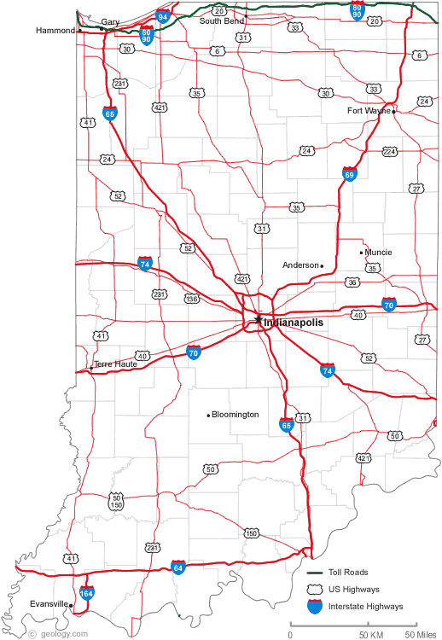
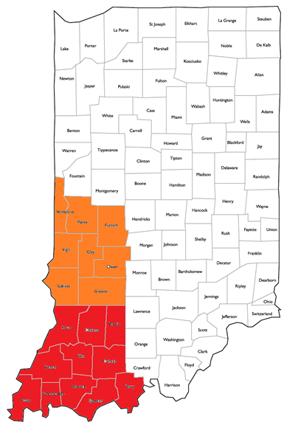
General Impact
Overview
Total Structures Damaged | 49,270
Total Injured | 639
Total Fatalities | 21
Total Without Power - Day 1 | 56,034
Total Without Water – Day 1 | 96,063

Slide 3
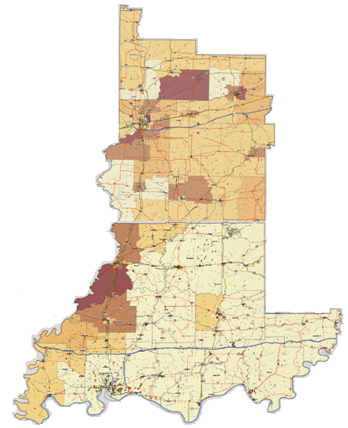
Building Damage:
Essential Facilities
Breakdown of Damage*
Hospitals | 328
Schools | 615
Fire Stations | 362
Police Stations | 166
* Damage defined as with functionality > 50% on day 1

Slide 4
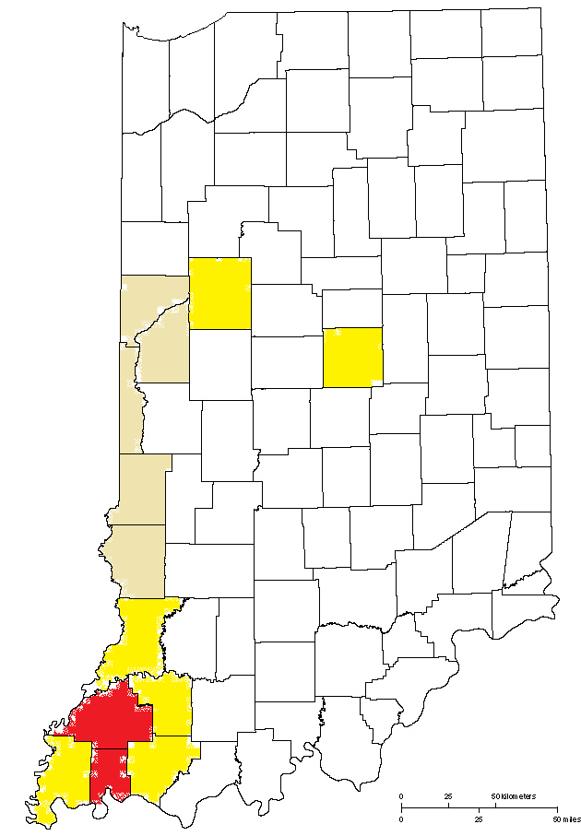
Total Number of Injured
Breakdown of Injuries
Medical Aid Needed | 490
Hospital Care Needed | 102
Life Threatening | 47
Total | 639

Slide 5
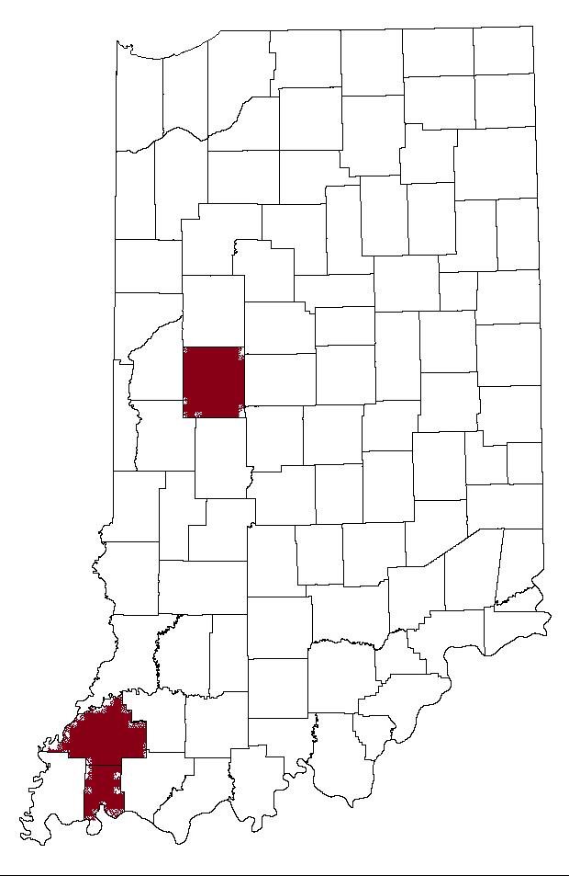
Total Number of Fatalities
Fatalities
Total | 21

Slide 6
Shelter Seeking Populations
Shelter Seeking by Day 3
Shelter Seeking | 49,396

Slide 7
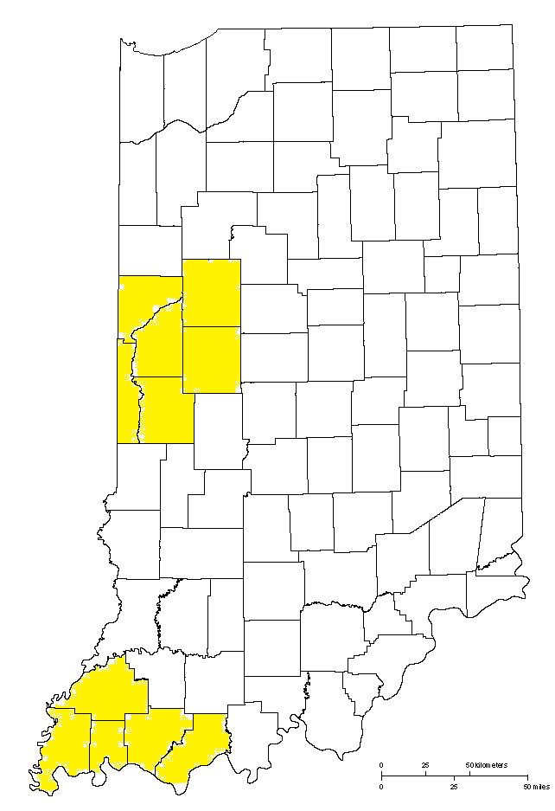
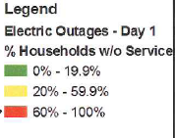
Power Disruptions
Number Affected
Total | 56,034

Slide 8
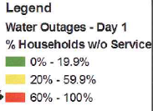
Water System Disruptions
Number Affected
Total | 96,063

Slide 9
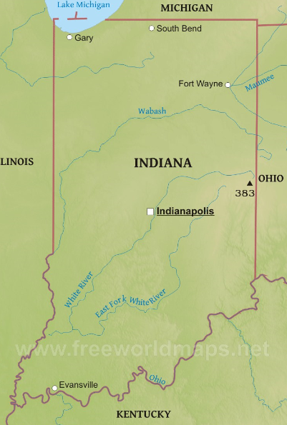
Immediate Priorities (E+72hrs)
Priorities
Notification/Situational Awareness
Assessment and Establishing Communications
Ingress / Egress Routes - Inspection/Assessment
Establish State Command Structure, District MACC’s
Establish State LSA
Critical Locations
State EOC
State Logistics Support Facility
State LSA - North
State LSA - South-
Marengo Cave Storage Facility - M

Slide 10
Indiana Resource Assessment

Slide 11
Planning Metrics
USAR – Major metropolitan areas, population of 100,000 or more with multi-story/multi-family structures
TRT – One per County for initial response
SAR – Three per County for initial response (Ground & Aerial)
IMT – Per Area Command, State Forward Operating Base, and established JRSOI
EOC Team – Per State EOC
EMAC A-Team – Per State EOC (24/7 shifts)
Bldg/Bridge Inspection – 4 Per County
HAZMAT – Known infrastructure assessment (refineries, chemical plants, etc)
Ambulance Strike Team – Based on population density, casualty estimates, and transport distance (5 ambulance per team)
Med ERT – Per Damage Estimate of Medical Infrastructure (2 per hospital)
Water Rescue – Per major waterway in impacted area
Commo Strike Team – 2 Per Area Command, 1 per State Forward Operating Base, and 1 per established JRSOI
Debris Removal – 1 per county
LE Strike Team – 2 per Area Command. 2 additional for population >100,000
Crowd Control - Major metropolitan areas, population of 100,000 or more

Slide 12
Planning Metrics
QUESTIONS?

