Slide 1
Kentucky Impact Overview
Capstone 14 Exercise

Slide 2
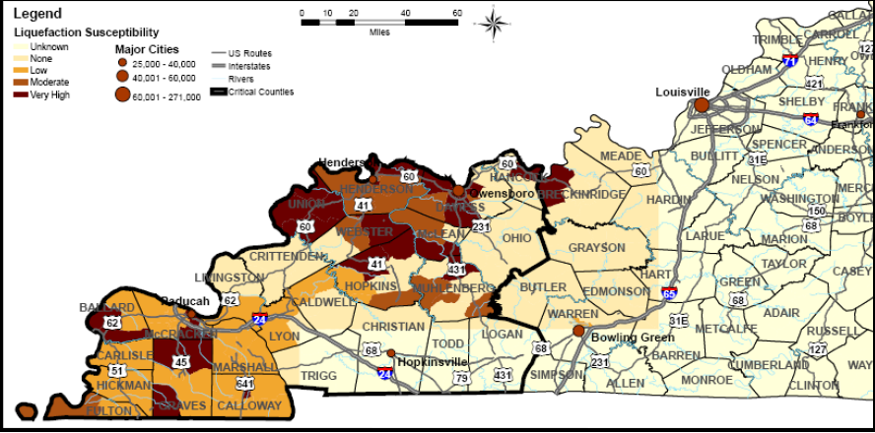
General Impact
Overview
Total Structures Damaged | 68,400
Total Injured | 6,000 +
Total Fatalities | 300
Total Seeking Shelter | 233,000 +
Total Households Without Power | 330,000
Total Households Without Water | 76,000

Slide 3
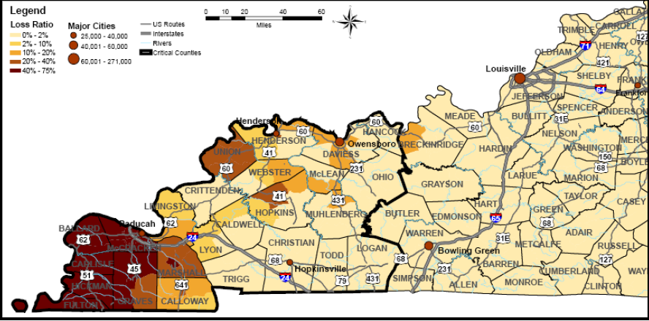
Building Damage
Breakdown of Damage
Residential | 64,900
Commercial, Industrial and Other | 3,500
Total | 68,400

Slide 4
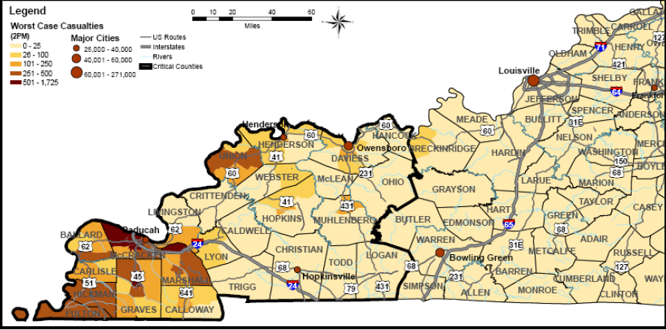
Total Number of Injured
Breakdown of Injuries
Medical Aid Needed | 4,977
Hospital Care Needed | 1353
Life Threatening | 153
Total | 6483

Slide 5
Total Number of Fatalities
Fatalities
Total | 300

Slide 6
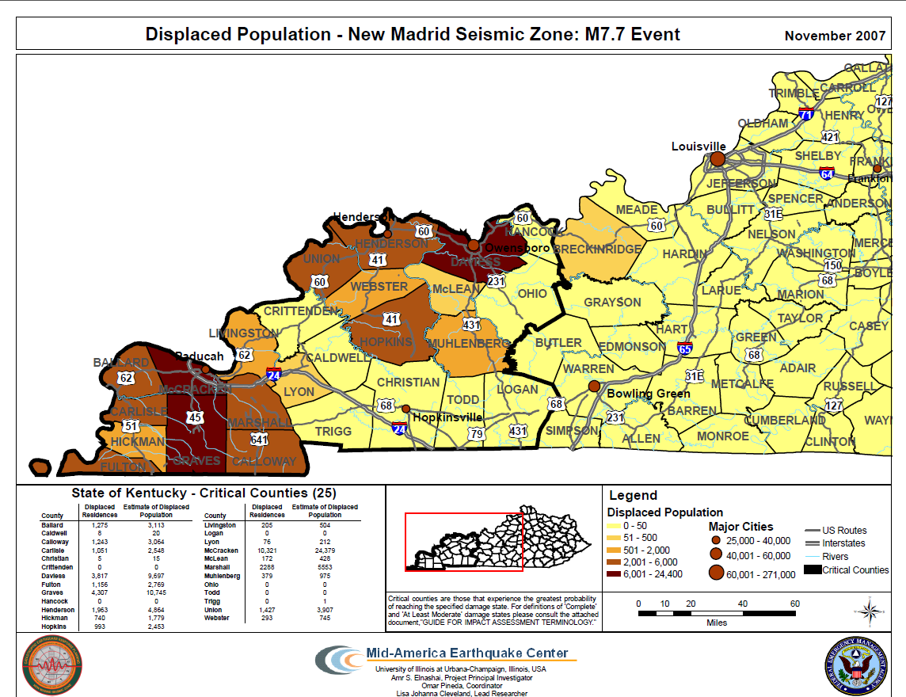
Shelter Seeking Populations
Shelter Seeking
Total | 233,000 +

Slide 7
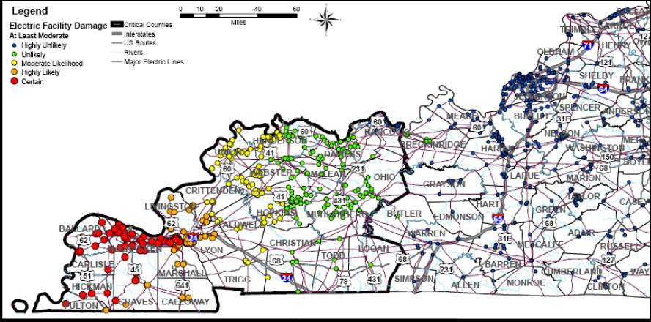
Power Disruptions
Number Affected
Total | 77,263 + Households

Slide 8
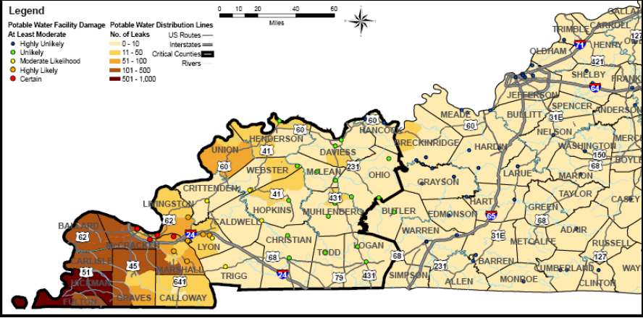
Water System Disruptions
Number Affected
Total | 108,000 + Households

Slide 9
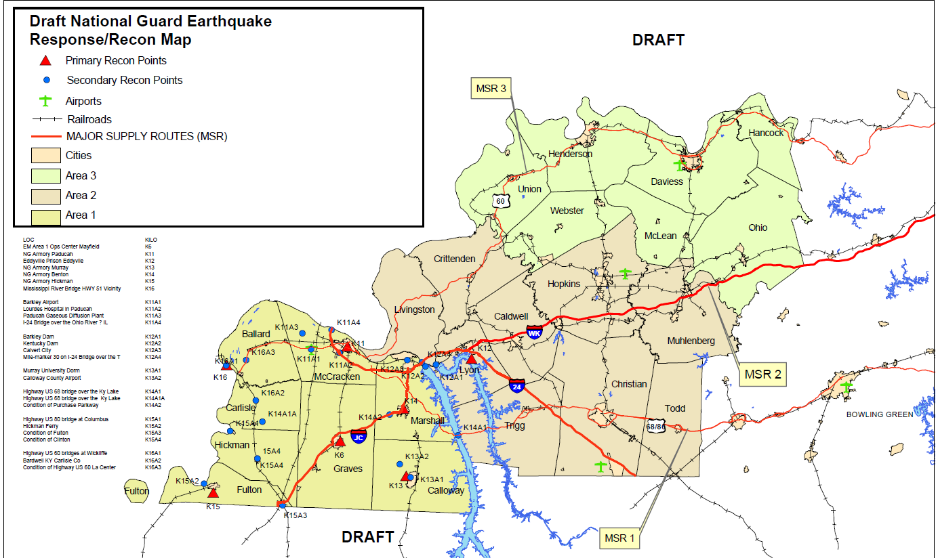
Immediate Priorities (E+72hrs)
Priorities
Activate Statewide Search and Rescue Response
Recon Tier I Named Areas of Interest (MSR’s, C2 , Infrastructure)
Establish JRSOI’s
Establish State Logistics Center
Critical Locations
Bowling Green Airport
Kentucky Dam
Wendell H. Ford Regional Training Ctr
Regional Coordination Center Initial Loc’s
Levees along the Mississippi
Ohio River Locks

Slide 10
Kentucky Resource Assessment

Slide 11
Planning Metrics (1st 30 days)
USAR – Based on minimal support to urban areas
TRT – N/A
SAR – Based on conducting initial focused SAR in specified areas then expanding to rural areas
IMT – Based on one per county, 1 per Regional Command and 1 per Unified Area Command
EOC Team – Per State EOC
EMAC A-Team – Per State EOC (24/7 shifts)
Bldg/Bridge Inspection – Based on minimum required bridges – based on estimated building destruction
HAZMAT – Known infrastructure assessment (refineries, chemical plants, etc)
Ambulance Strike Team – Casualty estimates, and transport distance (10 ambulance per team)
Med ERT – Per Damage Estimate of Medical Infrastructure (2 per hospital)
Water Rescue – Per major waterway in impacted area
Commo Strike Team – Based around support to command and control elements at county, region and area commands
Debris Removal – focused on counties estimated to have highest debris
LE Strike Team – Based on support to County Prisons, Two State Prisons
Crowd Control – Support to major evacuee centers

Slide 12
Planning Metrics
QUESTIONS?

