Slide 1
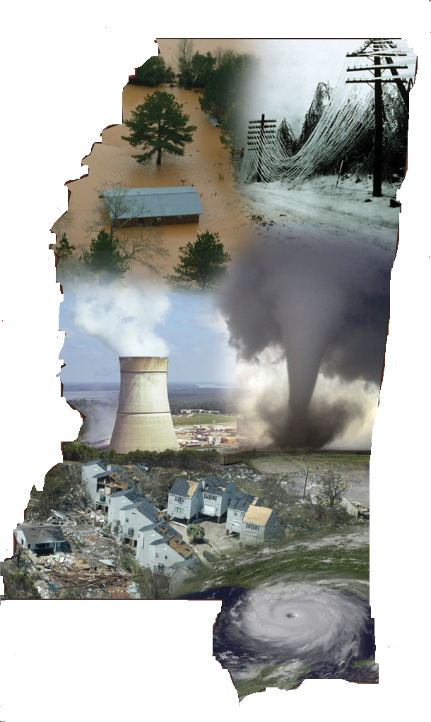
Mississippi Emergency Management Agency
Mississippi Impact Overview
Capstone 14
Tom McAllister
Response Director

Slide 2
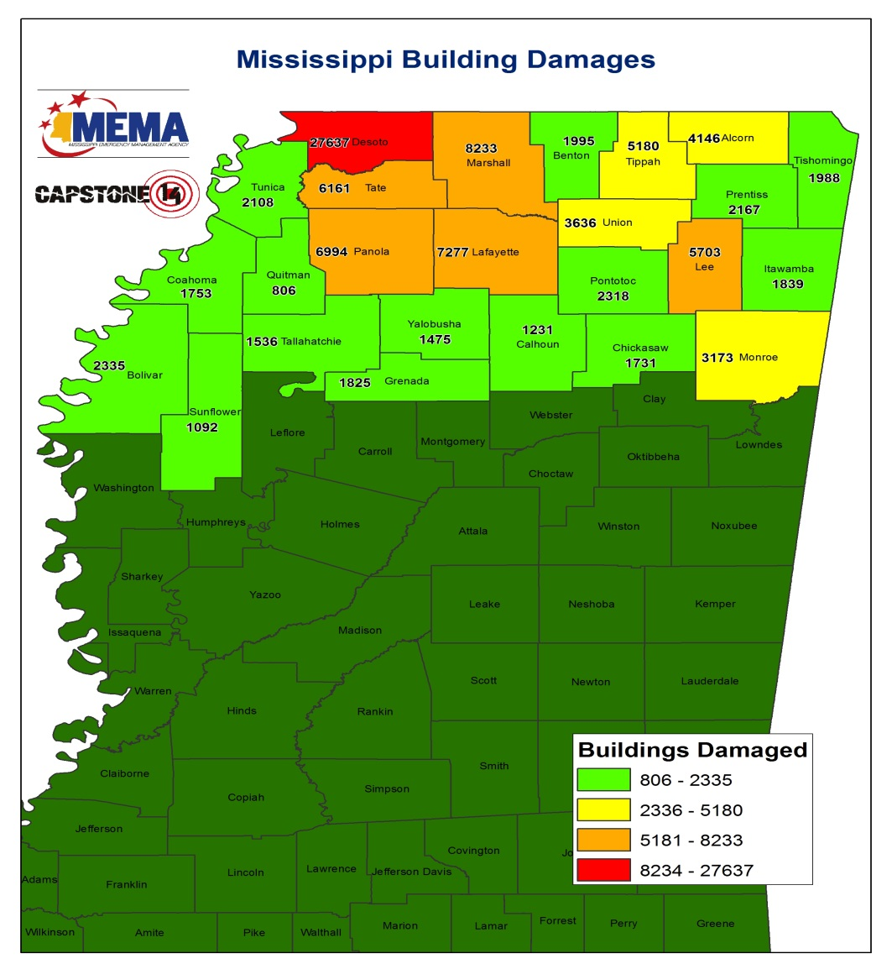
General Impact
Breakdown of Damage
Residential | 45,059
Commercial, Industrial and Other | 1,623
Total | 46,862

Slide 3
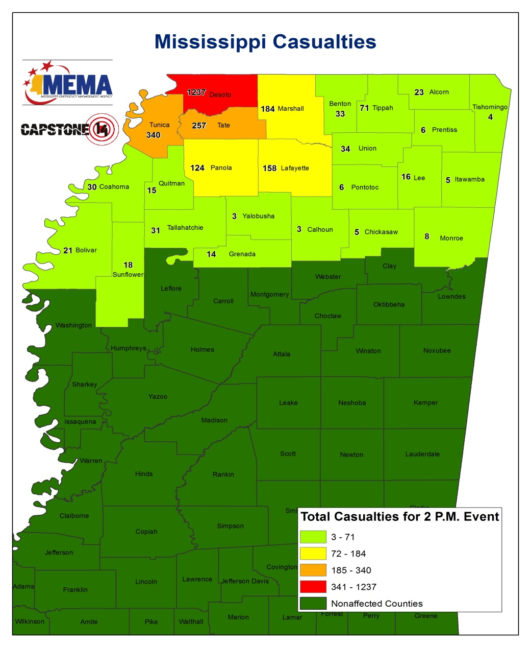
Total Number of Injured
Breakdown of Injuries
Medical Aid Needed | 4,000
Hospital Care Needed | 1,242
Life Threatening | 165
Total | 5,407

Slide 4
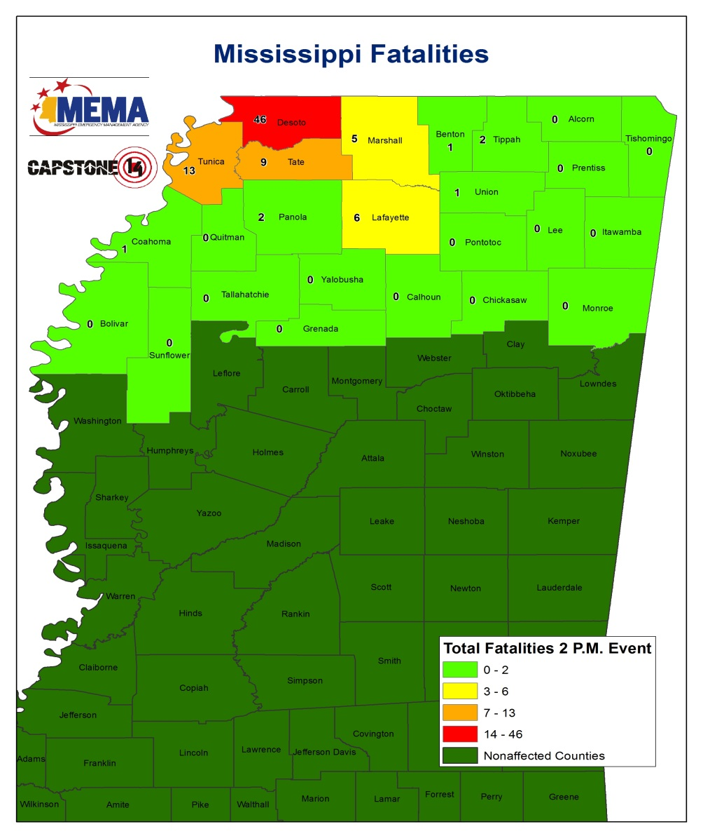
Total Number of Fatalities
Fatalities
Total | 200

Slide 5
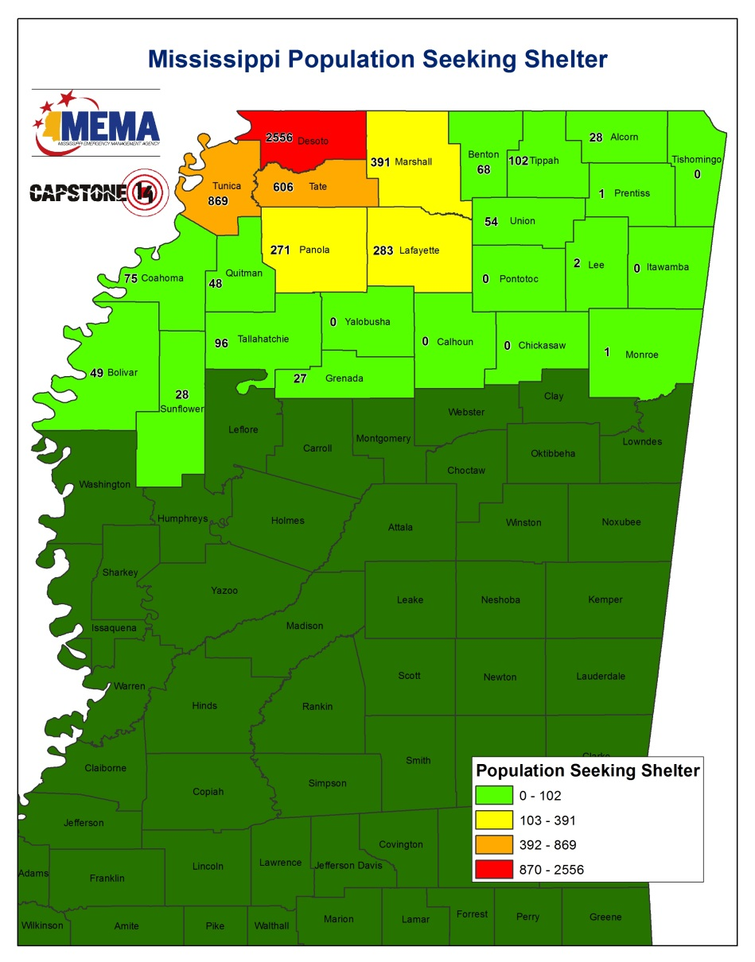
Shelter Seeking Populations
Shelter Seeking
Total | 25,000+

Slide 6
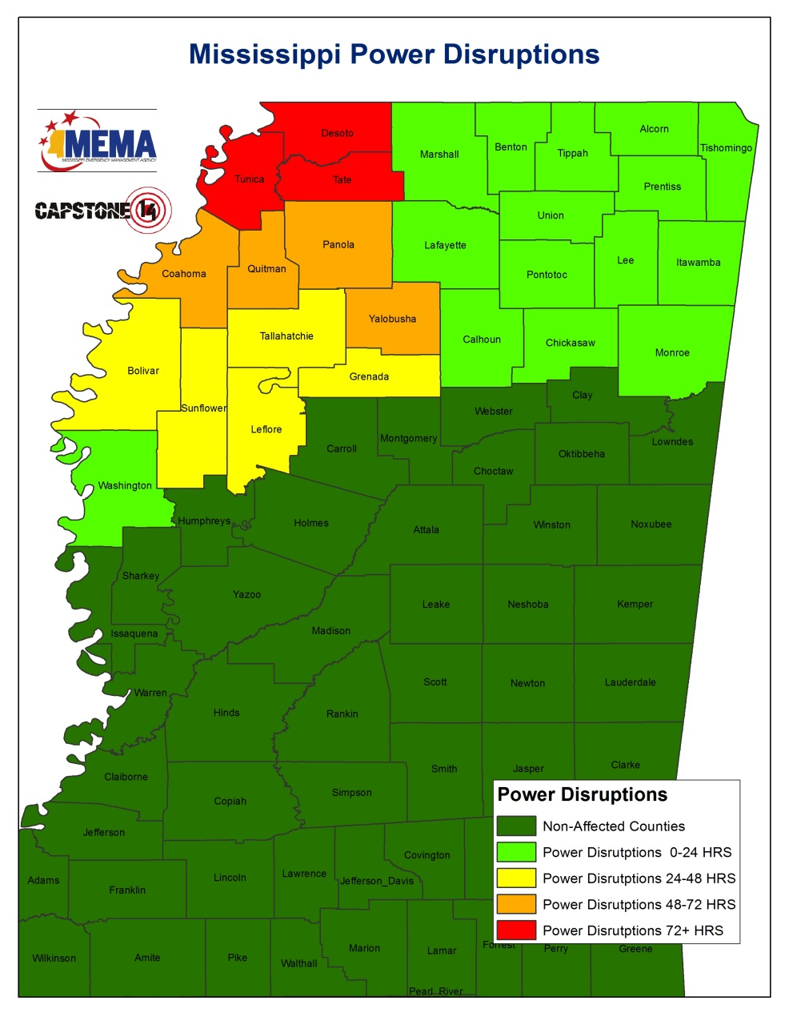
Power Disruptions
Number Affected
Total | 41,790+

Slide 7
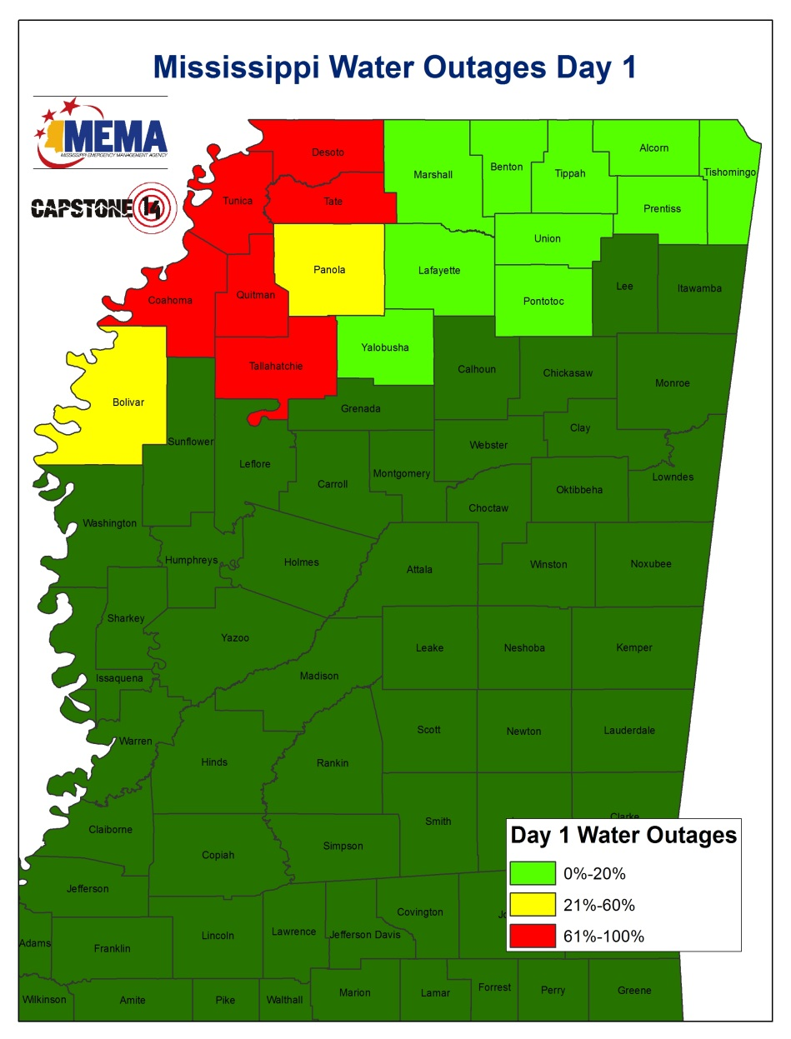
Water System Disruptions
Number Affected
Total | 108,556+

Slide 9
Immediate Priorities (E+72hrs)
Priorities
Major Supply Routes
Joint, Receiving, Staging, On-Ward Movement and Integration
State Forward EOC/ SERT
Commodity Staging Areas Medical Evacuation/ care of survivors Communications
Critical Locations
Northwest Community College
Robinsonville /Tunica county
Delta State University/ Bolivar Med Center
Coahoma Community College
Baptist Med Center, Desoto Hospital
Bridges and roads

Slide 10
Questions?
Mississippi Emergency Management Agency

