Slide 1
Missouri Impact Overview
Capstone 14 Exercise

Slide 2
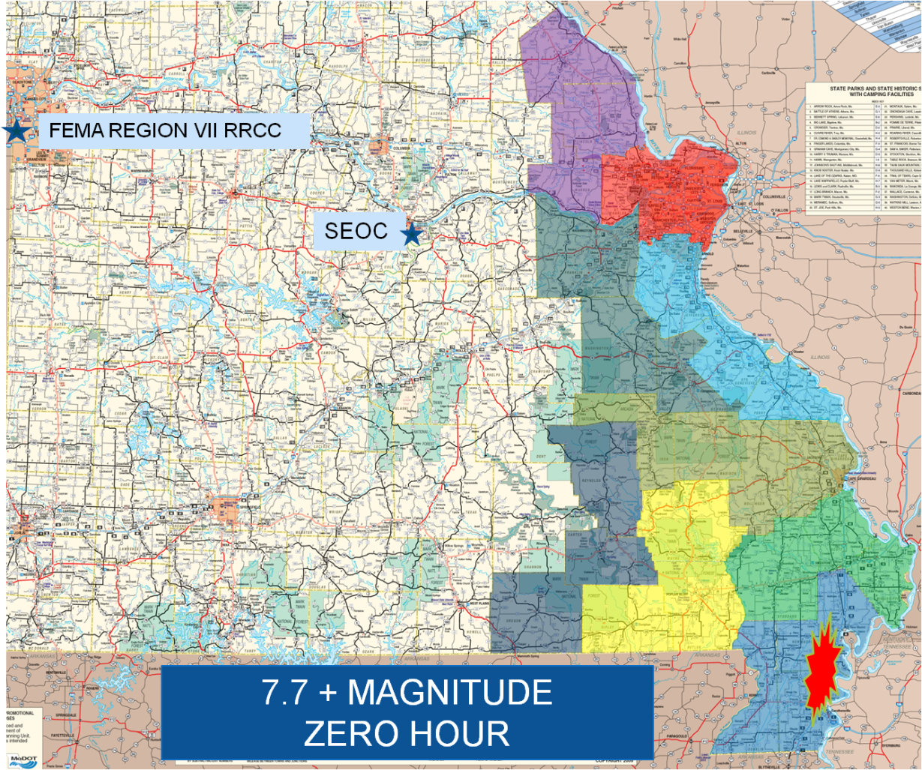
General Impact
Overview
Total Structures Damaged | 87,000
Total Injured | 13,444
Total Fatalities | 654
Total Seeking Shelter | 237,991
Total Without Power | 750,000 +
Total Without Water | 307,000 +

Slide 3
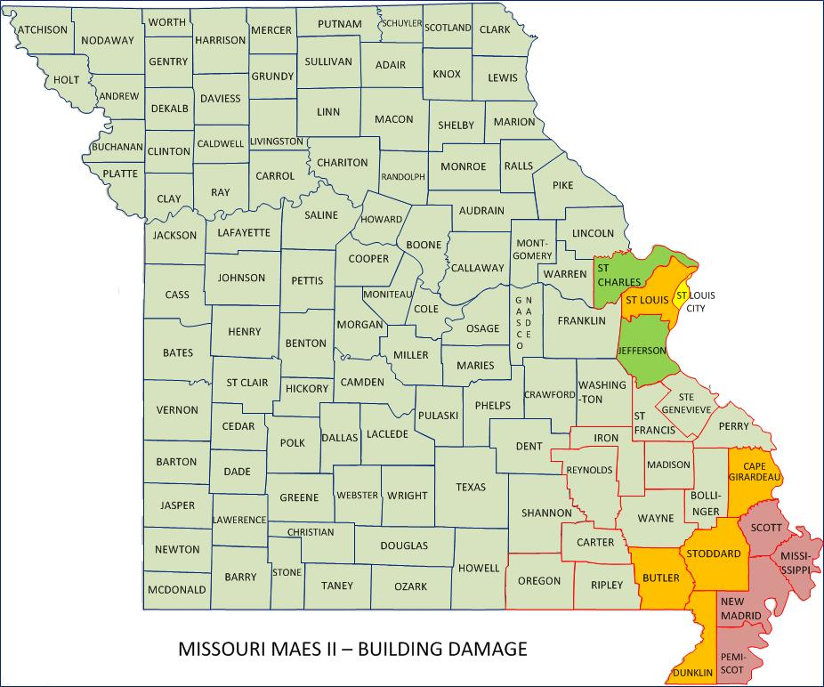
Building Damage
Breakdown of Damage
Residential | 83,600
Commercial, Industrial and Other | 2000 1200
Total | 86,800

Slide 4
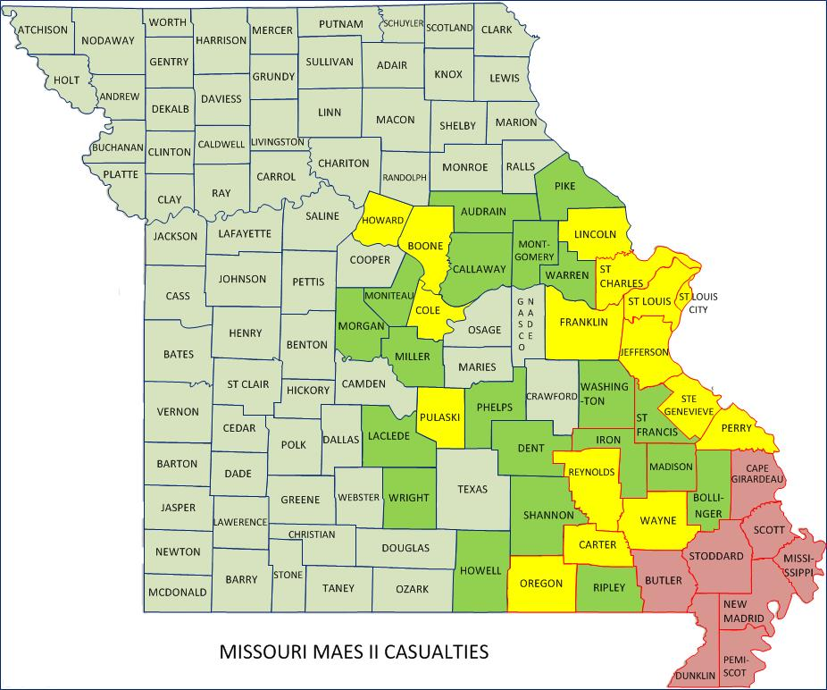
Total Number of Injured
Breakdown of Injuries
Medical Aid Needed | 10,179
Hospital Care Needed | 2,898
Life Threatening | 361
Total | 13,438

Slide 5
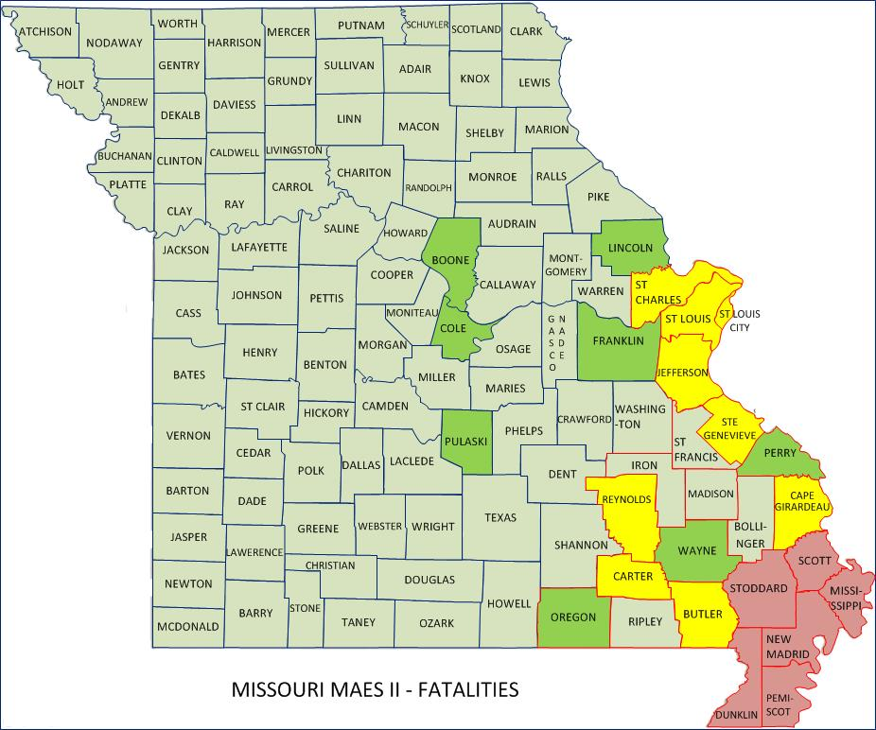
Total Number of Fatalities
Fatalities
Total | 687

Slide 6
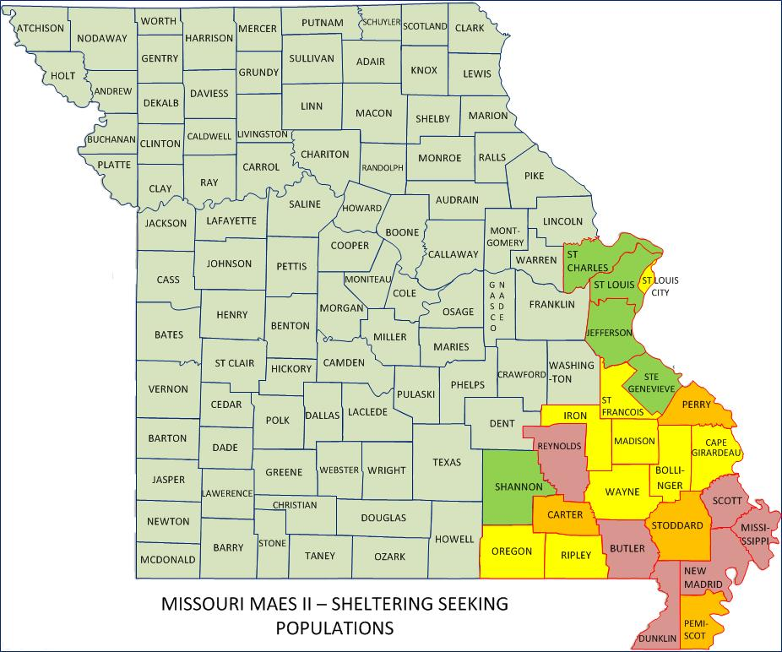
Shelter Seeking Populations
Shelter Seeking
Total | 237991 +

Slide 7
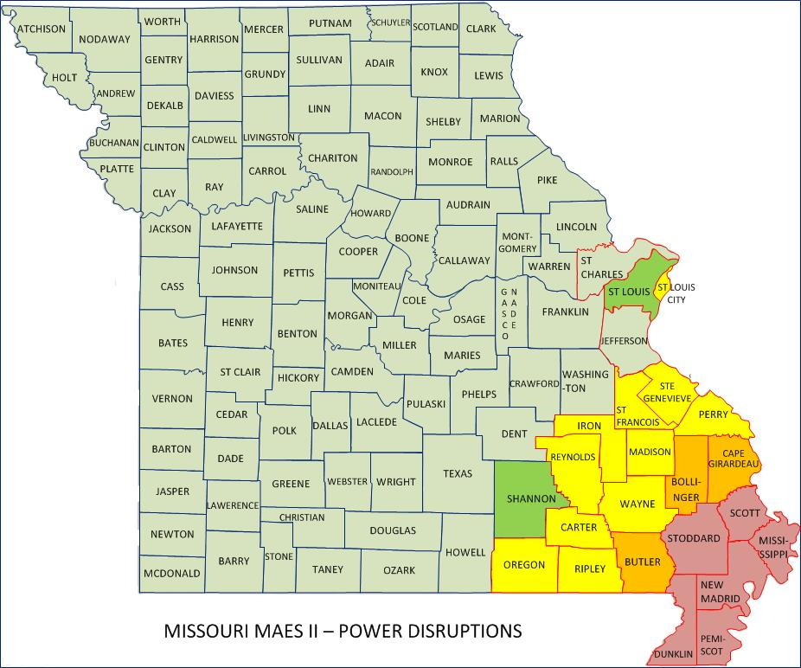
Power Disruptions
Number Affected
Total | 310,000 Households

Slide 8
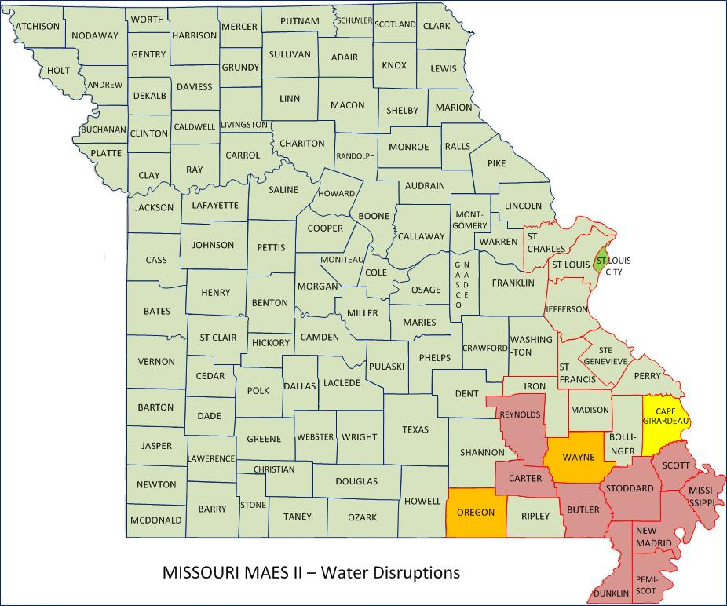
Water System Disruptions
Number Affected
Total | 124,000 Households

Slide 9
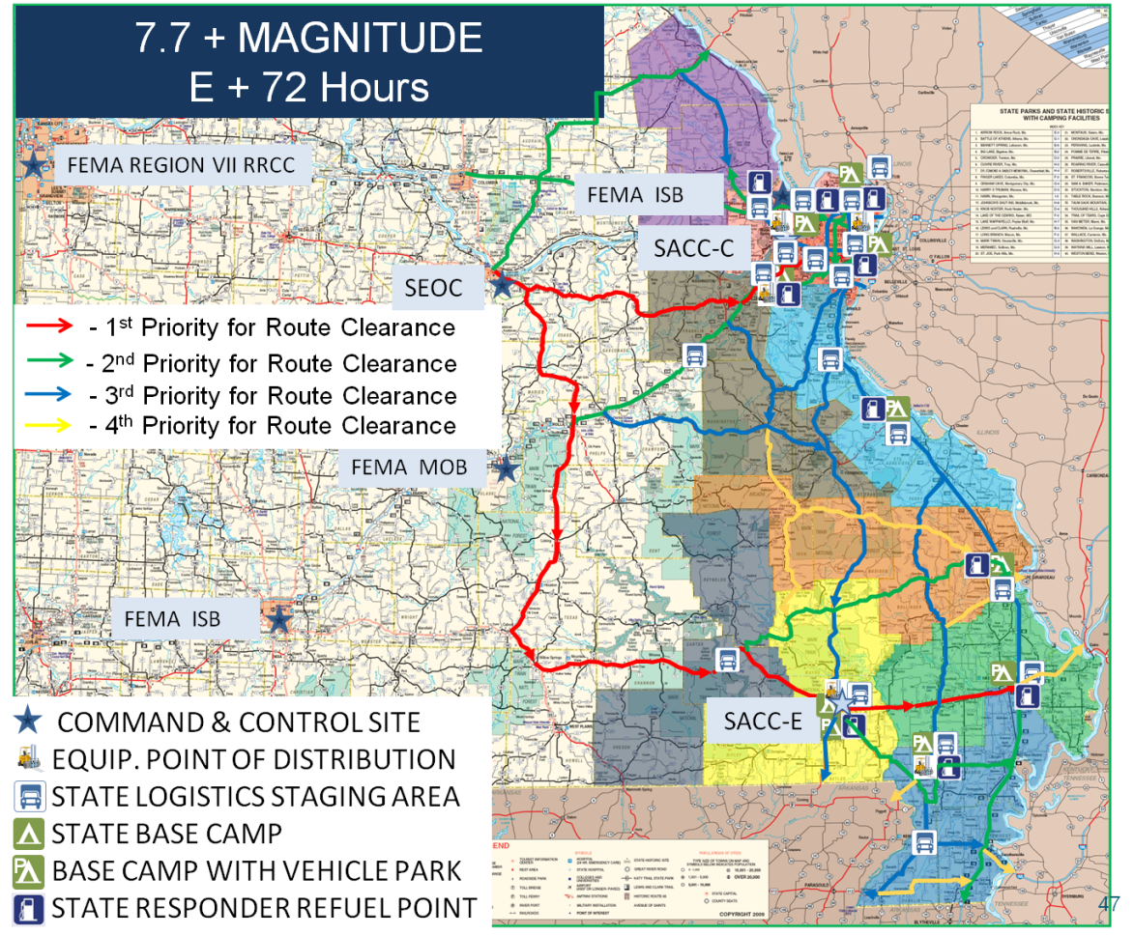
Immediate Priorities (E+72hrs)
Priorities
Life Saving
Clear Major Routes
Establish Reception Sites
Establish Logistical Bases
Establish Distribution Points
Critical Locations
Six Flags over St. Louis
Forrest Park, St Louis
St Charles Convention Center
St Charles Soccer Park
3 Rivers College, Poplar Bluff
Malden City Airport
Sikeston Fair Grounds

Slide 10
Missouri Resource Assessment

Slide 11
Planning Metrics
USAR – Per Joint FEMA/State Response Plan
SAR – Per Joint FEMA/State Response Plan
IMT – Per Joint FEMA/State Response Plan
EMAC A-Team – 2 to support state team (24/7 shifts)
Bldg/Bridge Inspection – ESF-3 & MODOT Initiated & supported
HAZMAT – Known infrastructure assessment (refineries, chemical plants, etc)
Ambulance Strike Team – Based on population density, casualty estimates, and transport distance (10 ambulance per team)
DMAT – Per ESF-8 Response Plan and casualty projections
DMORT – Per ESF-8 Response Plan and casualty projections
Rotary Ambulance – Per ESF-8 Response Plan and casualty projections
Rotary Observation and Transportation – Per ESF-1, ESF-9, ESF-13, ESF-16 response plans
Busses – Per ESF-1, ESF-6, ESF-7, ESF-8 response plans
Commo STS - Based on facilities activated
Debris Removal – 1 per county

Slide 12
Planning Metrics
QUESTIONS?

