Slide 1
Tennessee Impact Overview
Capstone 14 Exercise

Slide 2
General Impact
Overview
Total Structures Destroyed | 115,541
Total Injuries | 36,388
Total Fatalities | 2,178
Total Persons Seeking Temporary Shelter | 36,372 + (Day 1)
Total Households Without Power | 262,730 + (Day 1)
Total Households Without Water | 533,925 + (Day 1)

Slide 3
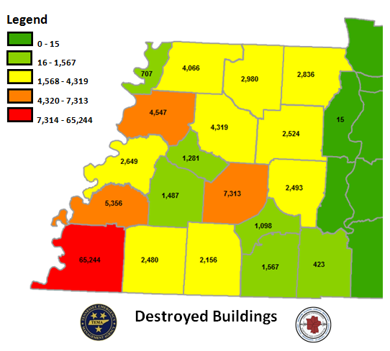
Building Damage
Building Damage Breakdown
Slight Damage | 108,755
Minor Damage | 61,003
Major Damage | 21,929
Destroyed: Residential Homes | 113,432
Destroyed: Non-Residential (commercial, industrial, etc.) | 2,109
Total Destroyed | 115,541

Slide 4
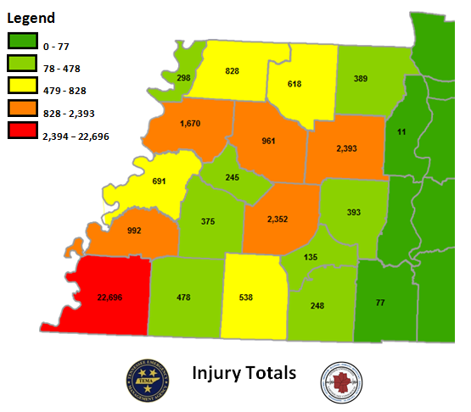
Total Number of Injuries
Breakdown of Injuries
Medical Aid Needed | 25,542
Hospital Care Needed | 7,675
Life Threatening | 1,180
Total | 36,388

Slide 5
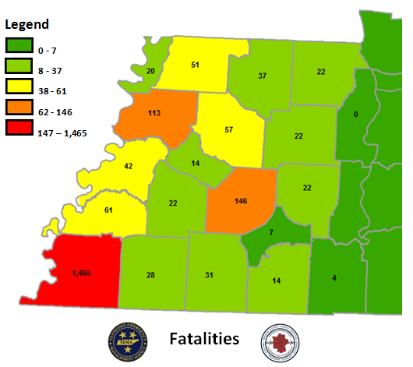
Total Number of Fatalities
Fatalities
Total | 2,178

Slide 6
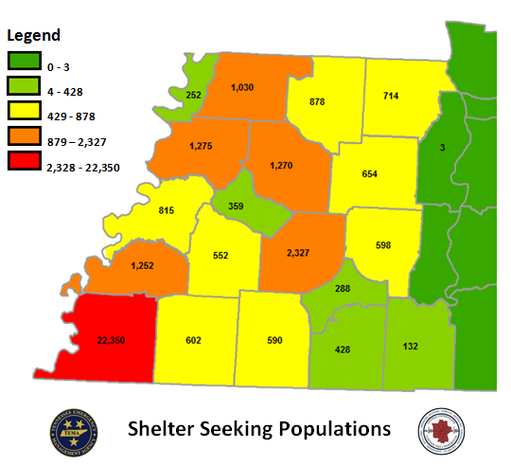
Shelter Seeking Populations
Persons Seeking Temporary Shelter
Total | 36,372 + (Day 1)

Slide 7
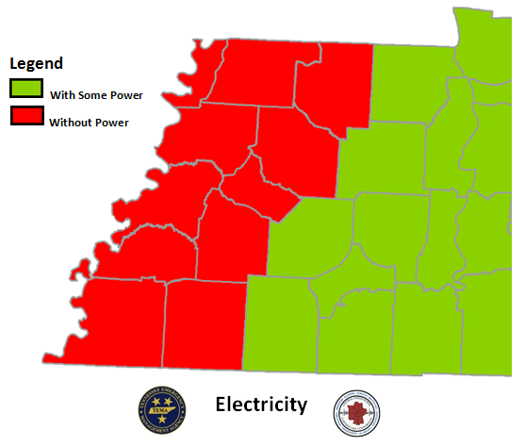
Power Disruptions
Households without Power
Total | 262,730 + (Day 1)

Slide 8
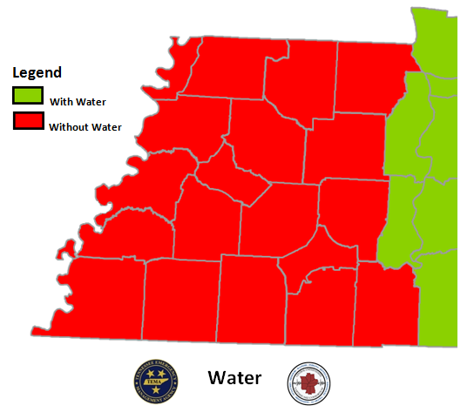
Water System Disruptions
Households without Water
Total | 533,925 + (Day 1)

Slide 9
Planning Metrics
USAR – Major metropolitan areas, population of 100,000 or more with multi-story/multi-family structures
TRT – One per County for initial response
SAR – One per County for initial response (Ground & Aerial)
IMT – Per Area Command, State Forward Operating Base, and established JRSOI
EOC Team – Per State EOC
EMAC A-Team – Per State EOC (24/7 shifts)
Bldg/Bridge Inspection – Per County
HAZMAT – Known infrastructure assessment (refineries, chemical plants, etc)
Ambulance Strike Team – Based on population density, casualty estimates, and transport distance (10 ambulance per team)
Med ERT – Per Damage Estimate of Medical Infrastructure (2 per hospital)
Water Rescue – Per major waterway in impacted area
Commo Strike Team – 2 Per Area Command, 1 per State Forward Operating Base, and 1 per established JRSOI
Debris Removal – 1 per county
LE Strike Team – 2 per Area Command. 2 additional for population >100,000
Crowd Control - Major metropolitan areas, population of 100,000 or more

Slide 10
Planning Metrics
QUESTIONS?

