Slide 1

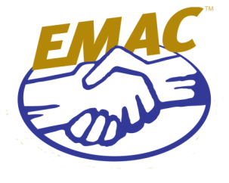


Resource Allocation Workshop (RAW) II Illinois Brief Out
November 4-5, 2013
N. Little Rock, Arkansas

Slide 2
Participants
Illinois Emergency Management Agency
Illinois National Guard
Iowa Emergency Management Agency
Wisconsin Emergency Management Agency
Wisconsin National Guard
American Red Cross

Slide 3
Topics of Discussion
Resource allocation
Illinois’ JRSOI process
Mass Care needs
Bears Packers Game

Slide 4
Issues Resolved
Initial resource needs (days 1-3)

Slide 5
Issues Pending Resolution
Bridge and building inspector packaging.
Local/county assets.
Mass Care needs.
National Guard integration.

Slide 6
Additional Clarification/Information
Pre-scripted mission assignments need to be formally worked out by legal/state directors.

Slide 7
Status of Resource Needs
Resource Gaps
Search & Rescue
Law Enforcement Strike Team
Law Enforcement Crowd Control Team
Bridge Inspection Team
Building Inspection Team
Incident Management Team Type I & II
Water Rescue Team
Debris Removal Team
*still need to coordinate resources with Minnesota

Slide 8
Questions?

