Slide 1




Resource Allocation Workshop (RAW) II Indiana Brief Out
November 4-5, 2013
N. Little Rock, Arkansas

Slide 2
Participants
Indiana DHS
Ohio EMA
NGB
Red Cross
With Support from Arkansas DEM

Slide 3
Topics of Discussion
Resource Gaps
NIMS Typing
Definitions on Planning Metrics

Slide 4
Issues Resolved
Identified available resources from Ohio.
Michigan not present.
Discussed Mass Sheltering resources available from Red Cross

Slide 5
Issues Pending Resolution
Indiana, Michigan and Ohio to have meeting on Dec 4th to engage Michigan to continue address resource gaps.
Supporting States, Michigan and Ohio still working on developing additional Mission Ready Packages.

Slide 6
Additional Clarification/Information
Definitions of the 17 capabilities need to be better defined.
Not all 17 Capabilities are NIMS typed.

Slide 7
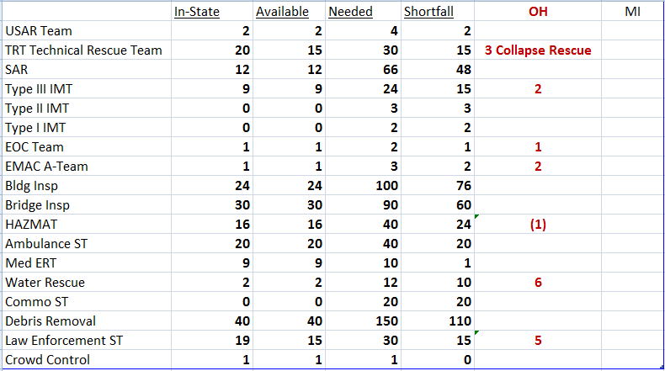
Status of Resource Needs

Slide 8
Additional Comments
None

Slide 9
Questions?

